Slide 1
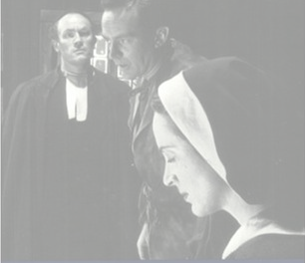
The Crucible
Act II

Slide 2
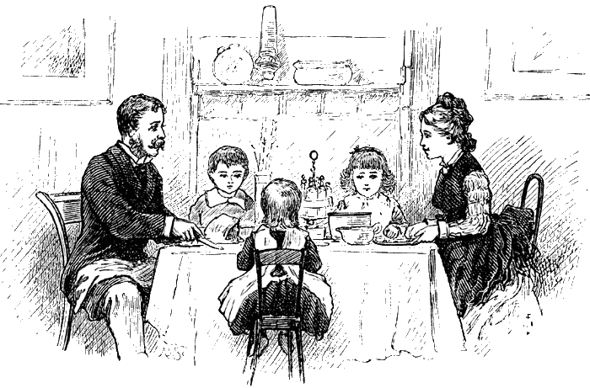
John Proctor sits down to dinner with his wife, Elizabeth.
Mary Warren, their servant, has gone to the witch trials, against Elizabeth’s order that she remain in the house.

Slide 3
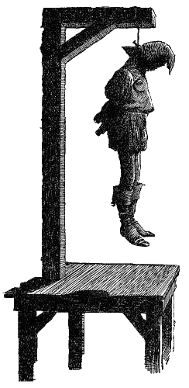
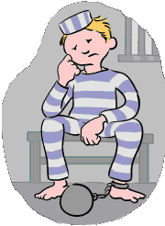
Fourteen people are now in jail.
If these accused witches do not confess, they will be hanged.
Whoever Abigail and her friends name as they go into hysterics is arrested for bewitching the girls.

Slide 4
Proctor can barely believe the craziness, and he tells Elizabeth that Abigail had said her dancing had nothing to do with witchcraft.
Elizabeth wants him to testify that the accusations are fake.

Slide 5
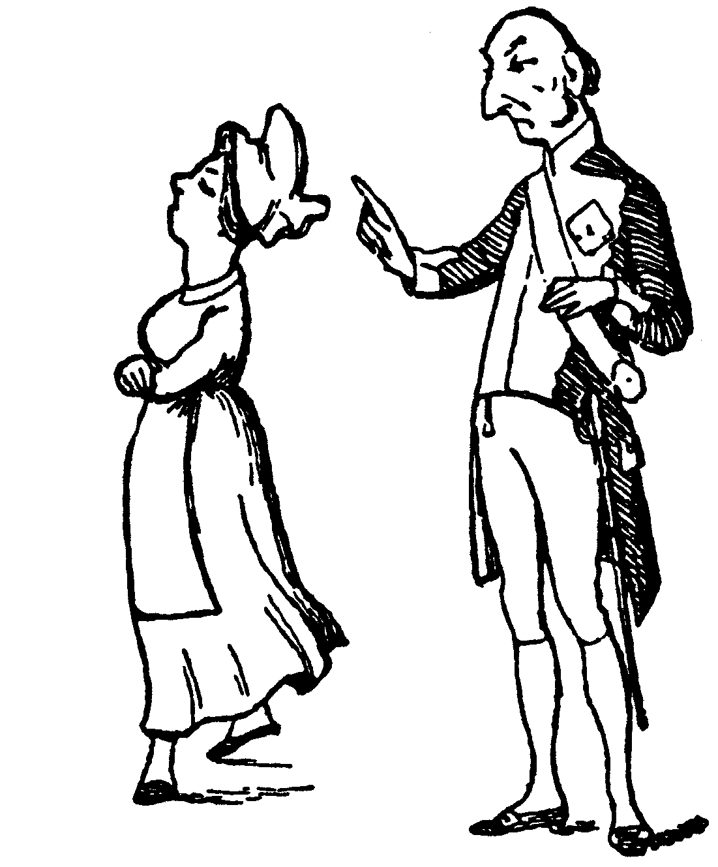
He says that he cannot prove his it because Abigail told him while they were alone in a room.
Elizabeth loses all faith in him when she hears that he and Abigail were alone together.

Slide 6
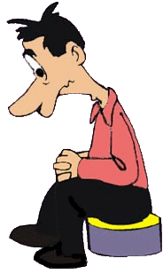
Proctor demands that she stop judging him.
He says that he feels as though his home is a courtroom.
Elizabeth responds that the real court is in his own heart.

Slide 7
When Mary Warren returns home, she gives Elizabeth a poppet (doll) that she sewed in court, saying that it is a gift.

Slide 8
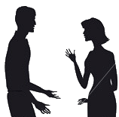
She reports that thirty-nine people now stand accused.
John and Mary argue over whether Mary can continue attending the trials.

Slide 9
He threatens to whip her, and Mary declares that she saved Elizabeth’s life that day.
Elizabeth’s name was apparently mentioned in the accusations (Mary will not name the accuser), but Mary spoke out in Elizabeth’s defense.

Slide 10
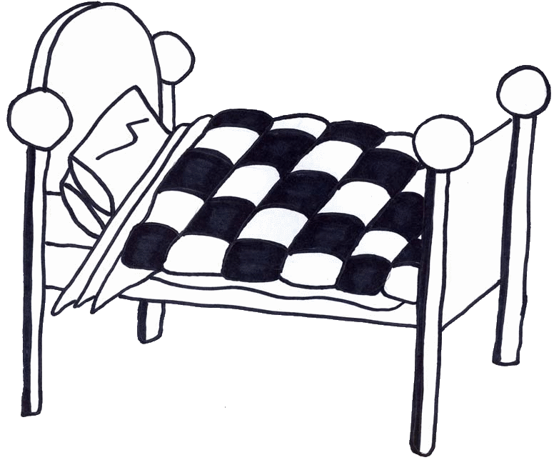
Proctor instructs Mary to go to bed, but she demands that he stop ordering her around.
Elizabeth, meanwhile, is convinced that it was Abigail who accused her of witchcraft, in order to take her place in John’s bed.

Slide 11
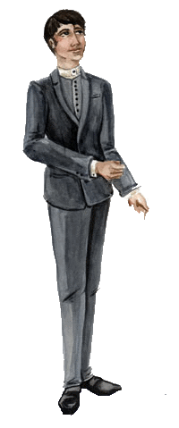
Hale visits the Proctors because he wants to speak with everyone whose name has been mentioned in connection with witchcraft.
He has just visited Rebecca Nurse.

Slide 12
Hale proceeds to ask questions about the Christian character of the Proctor home.
He notes that the Proctors have not often attended church and that their youngest son is not yet baptized.

Slide 13
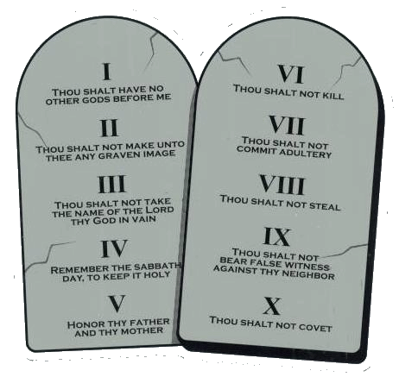
Proctor explains that he does not like Parris’s preaching.
Hale asks them to recite the Ten Commandments.
Proctor tries… but forgets one…..

Slide 14
At Elizabeth’s urging, Proctor informs Hale that Abigail told him that the children’s sickness had nothing to do with witchcraft.
Taken aback, Hale replies that many have already confessed.
Proctor points out that they would have been hanged without a confession.

Slide 15
Giles and Francis rush into Proctor’s home, crying that their wives have been arrested.
Rebecca is charged with the supernatural murders of Mrs. Putnam’s babies.

Slide 16
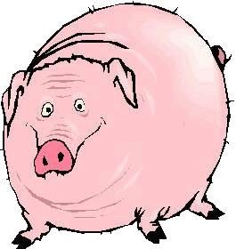
A man bought a pig from Martha Corey and it died not long afterward; he wanted his money back, but she refused, saying that he did not know how to care for a pig.

Slide 17
Every pig he purchased thereafter died, and he accused her of bewitching him so that he would be incapable of keeping one alive.

Slide 18
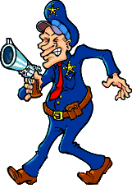
Ezekiel Cheever and Herrick, the town marshal, arrive with a warrant for Elizabeth’s arrest.
Hale is surprised because, last he heard, Elizabeth was not charged with anything.

Slide 19
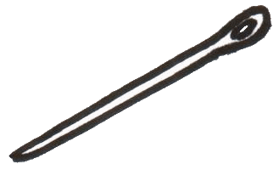
Cheever asks if Elizabeth owns any dolls, and Elizabeth replies that she has not owned dolls since she was a girl.
Cheever spies the doll Mary Warren gave her.
He finds a needle inside it.

Slide 20
Cheever relates that Abigail had a fit at dinner in Parris’s house that evening.
Parris found a needle in her abdomen, and Abigail accused Elizabeth of witchcraft.
Elizabeth brings Mary downstairs.
Mary informs the inquisitors that she made the doll while in court and stuck the needle in it herself.

Slide 21
As Elizabeth is led away, Proctor loses his temper and rips the warrant.
He asks Hale why the accuser is always considered innocent.
Hale appears less and less convince of the existence of witchcraft in Salem.

Slide 22
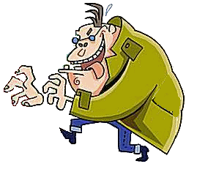
Proctor tells Mary that she has to testify in court that she made the doll and put the needle in it.
Mary declares that Abigail will kill her if she does and that Abigail would only charge him with lechery.

Slide 23
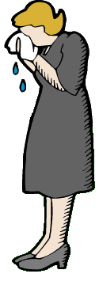
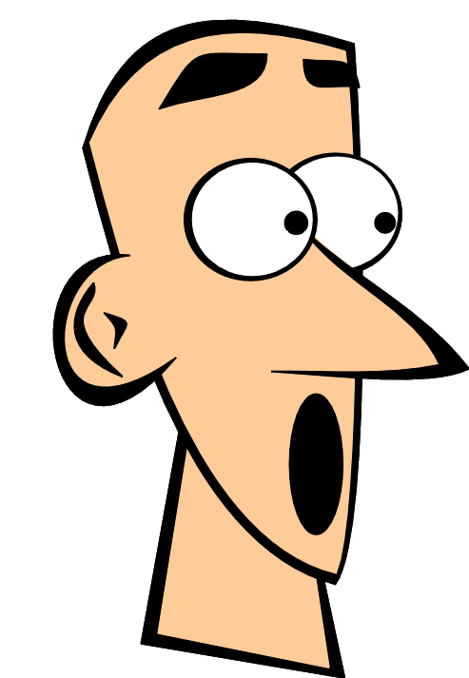
Proctor is shocked that Abigail told Mary about the affair, but he demands that she testify anyway.
Mary cries hysterically that she cannot.

